Slide 1

Vel Tech Rangarajan Dr. Sagunthala R&D Institute of Science and Technology
School of Computing
Department of Computer Science and Engineering
10211CS224 / FULL STACK APPLICATION DEVELOPMENT (JAVA)
END SEMESTER PROJECT REVIEW
Date: 06-05-2026
Smart Study Planner
SDG: SDG No – SDG Title(Example: SDG 4 – Quality Education)
Presented By:
STUDENT NAME: Kopparthi Sai Pavan – VTU25916 – Reg.No.23UESS0036
Courses Handling Faculty:
Dr. Shahul Hameed C, PhD., M.E., B.E., DCE , TTS3981Assistant Professor

Slide 2
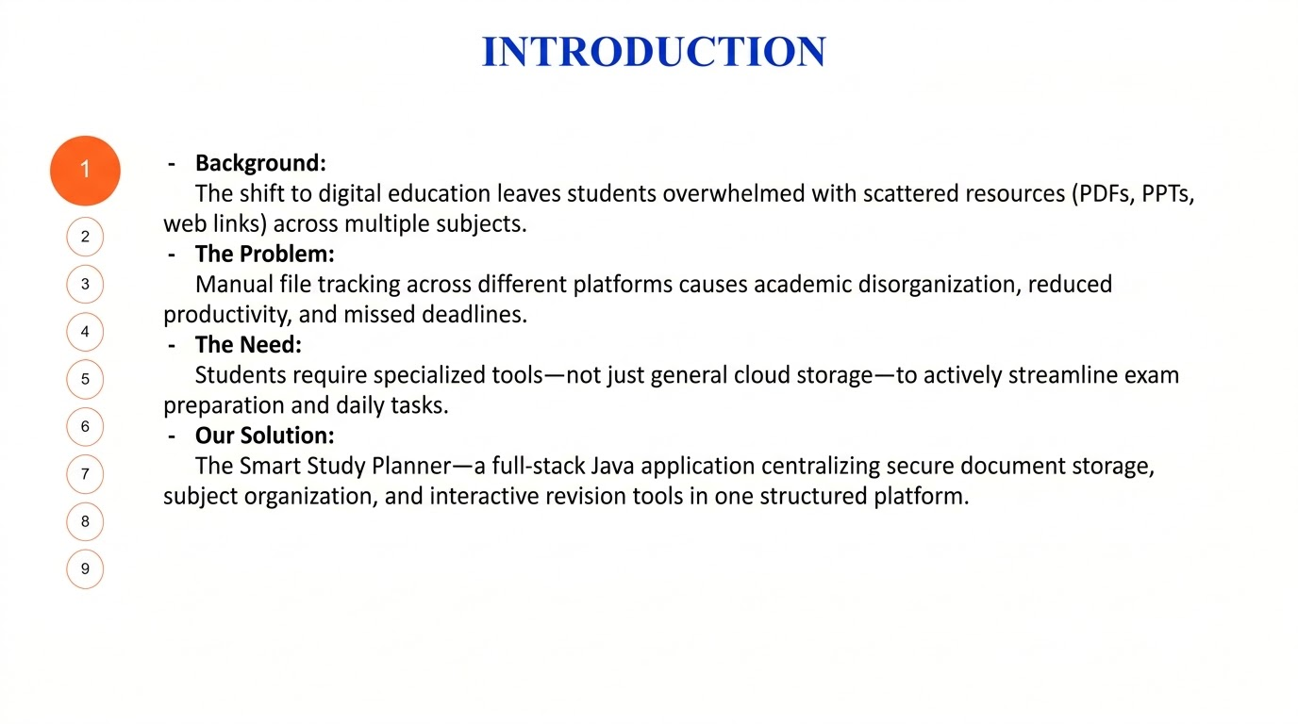

Slide 3
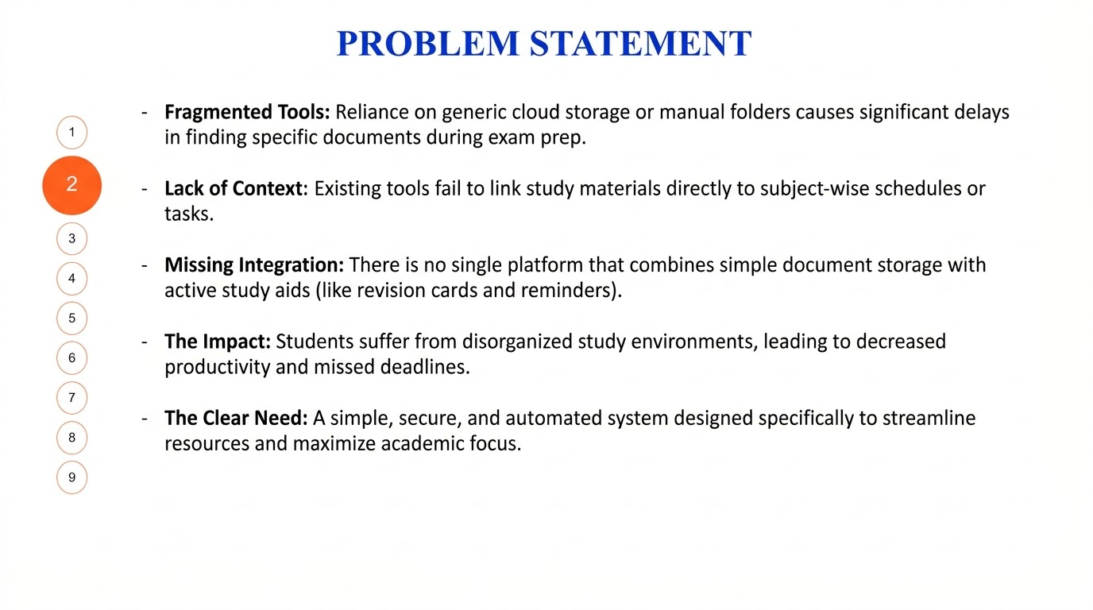

Slide 4
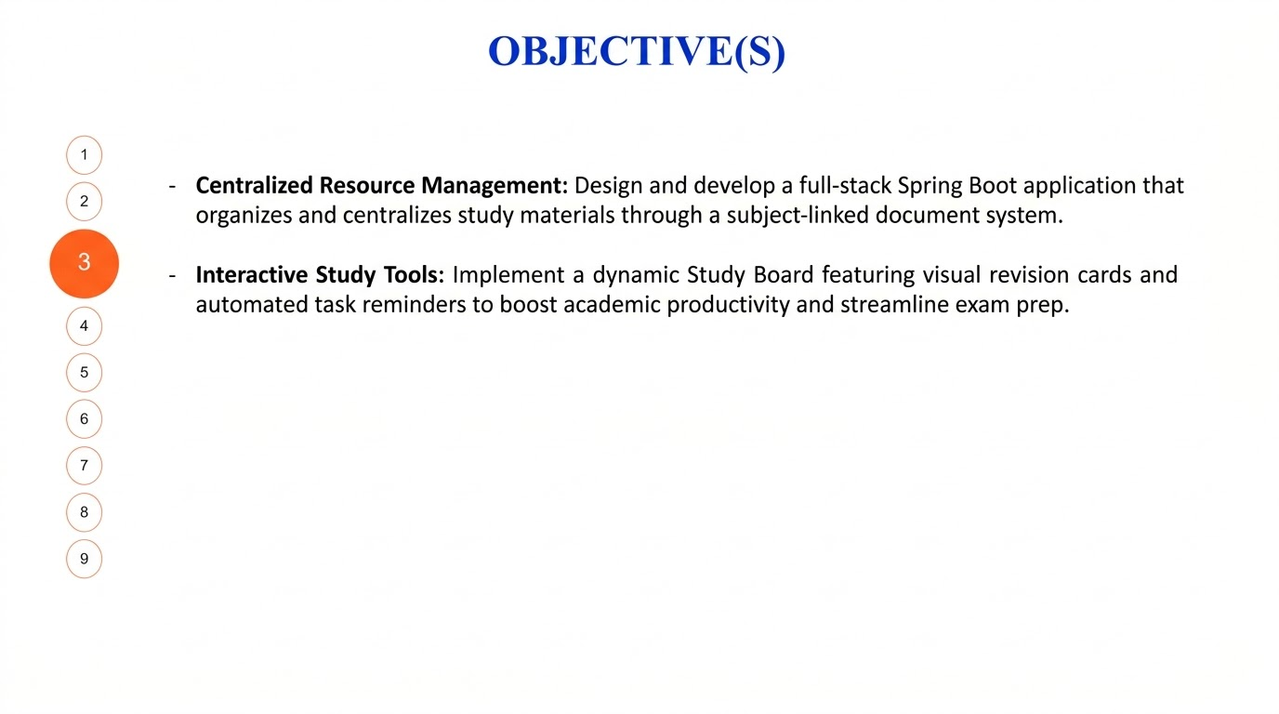

Slide 5
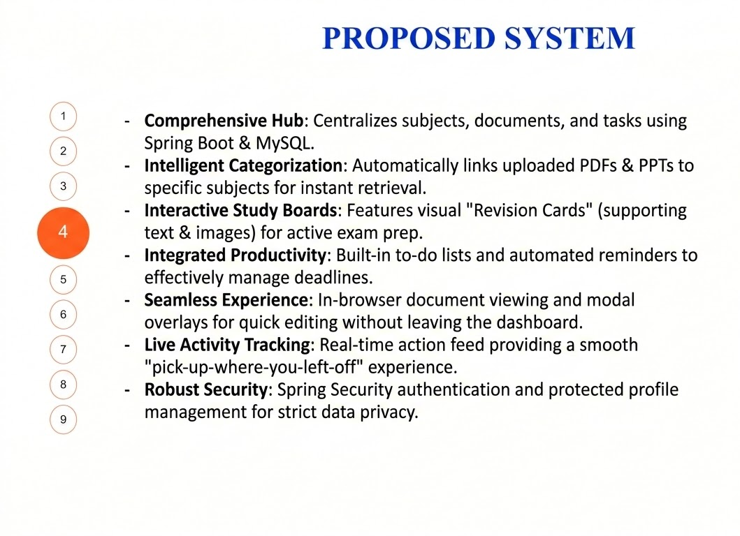

Slide 6
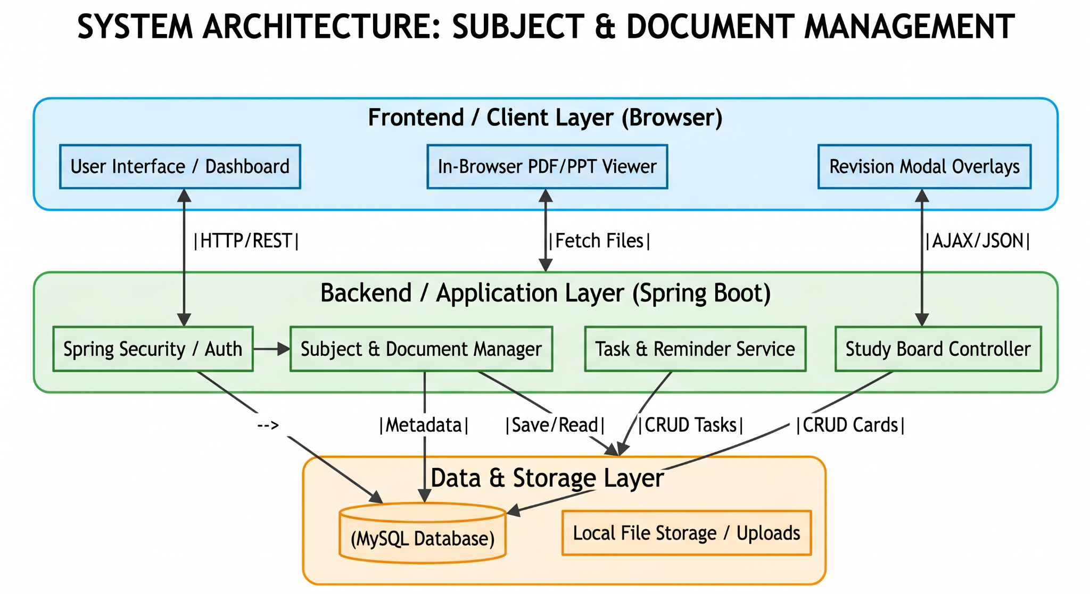
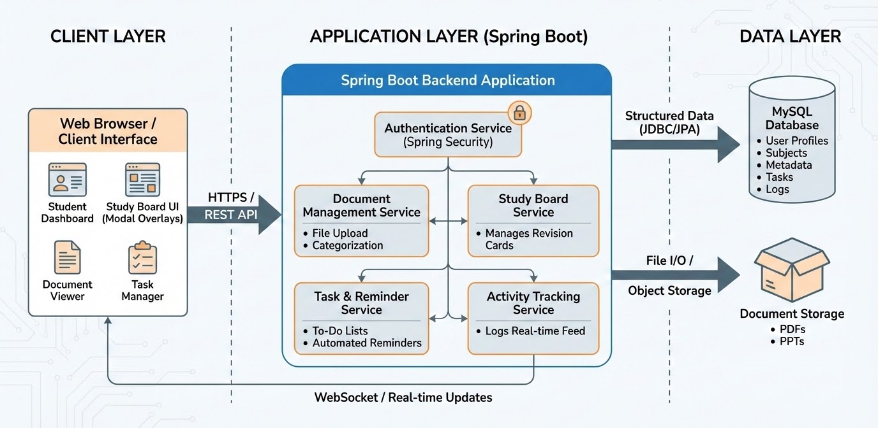
PROPOSED SYSTEM ARCHITECTURE
1
2
3
4
5
6
7
8
9

Slide 7
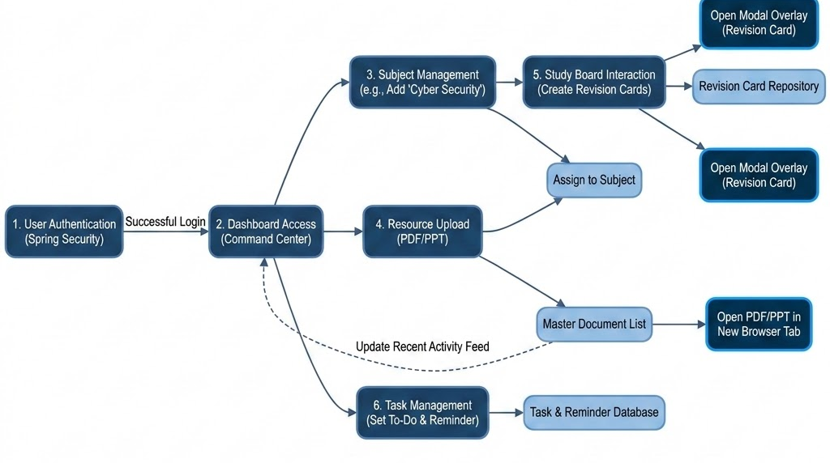
WORKFLOW
1
2
3
4
5
6
7
8
9

Slide 8
TECHNOLOGIES USED
Frontend:
HTML, CSS, Postman,thymeleaf
Backend:
Spring Boot, Java (JDK 17+), Spring Web (REST API).
Database:
MySQL
Third-Party API: Mistral ai
Tools:Postman, IntelliJ IDEA / Eclipse, Maven (build tool).
Hardware:
Minimum 4GB RAM,
Laptop/Desktop System.
Software Requirements:
Java JDK 17+,
Spring Boot,
MySQL,
IntelliJ / Eclipse IDE,
Postman
1
2
3
4
5
6
7
8
9

Slide 9
MODULE DESCRIPTION
Module 1: User Authentication & Security
Manages secure user registration and login using Spring security
Provides profile management, including data updates and password encryption
Module 2: Content & Resource Management
Handles the core logic for adding, editing, and deleting Subjects
Facilitates the Smart Upload of PDFs and PPTs, linking files directly to their respective subject categories
Module 3: Interactive Revision Board :
Implements the Revision Card system, allowing users to create study aids with text and images.
Includes the Modal Overlay feature for quick content viewing and live editing without page reloads.
Module 4: Productivity & Activity Tracker
Manages the To-Do List and automated reminders for academic tasks.
Generates the Recent Activity Feed on the Dashboard to provide a chronological log of user progress
Module 5: AI powers asssist
Integrates the mistral api to provide intelligent aware study assitance
1
2
3
4
5
6
7
8
9

Slide 10
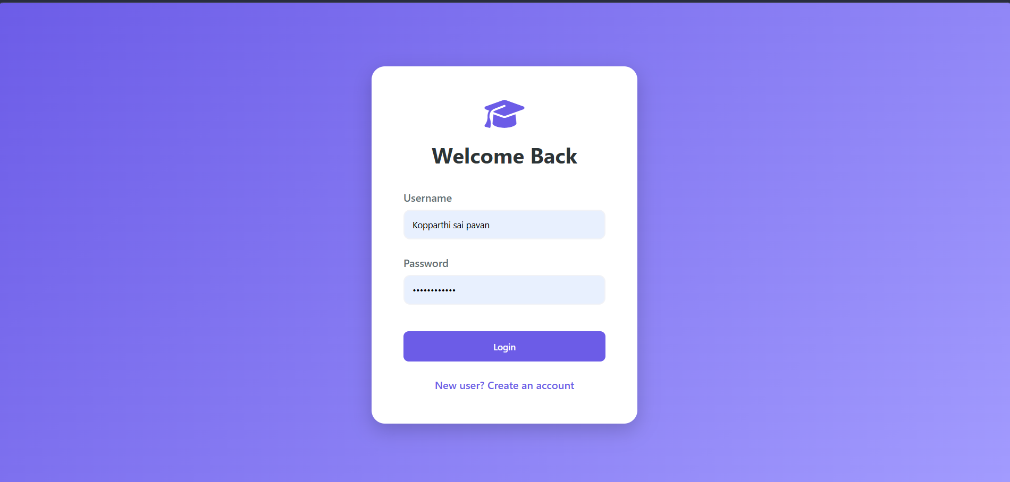
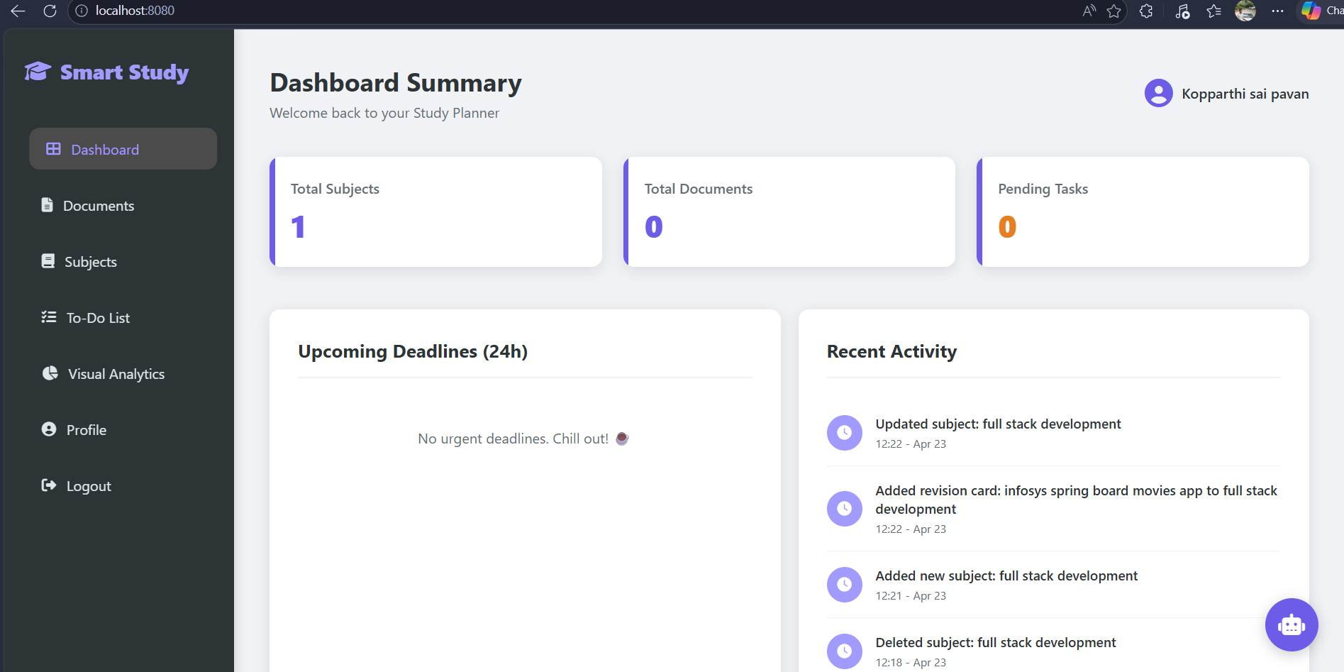
IMPLEMENTATION SCREENSHOTS
1
2
3
4
5
6
7
8
9

Slide 11
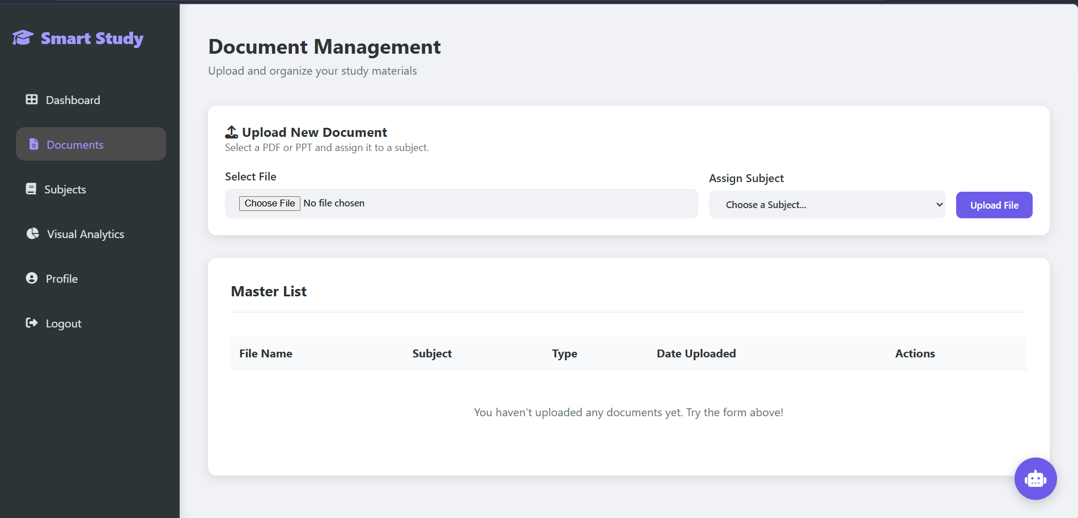
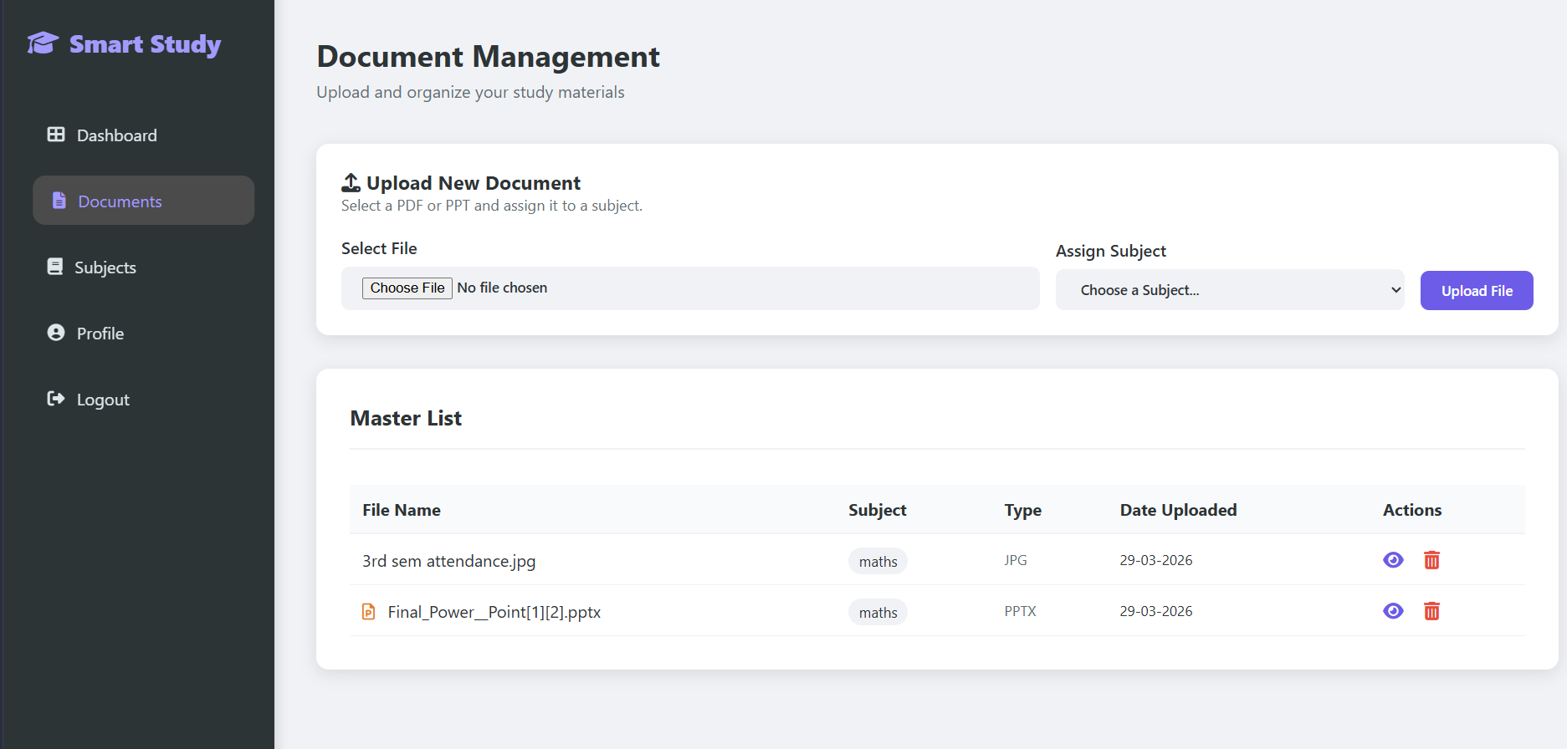
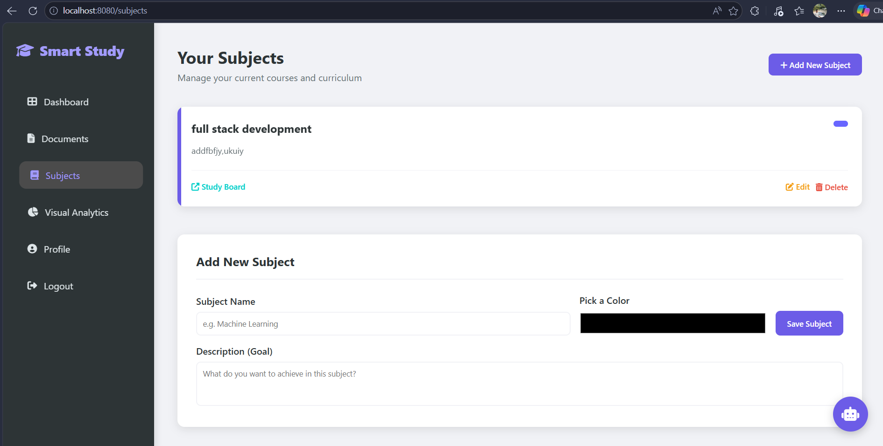
IMPLEMENTATION SCREENSHOTS
1
2
3
4
5
6
7
8(A)
9

Slide 12
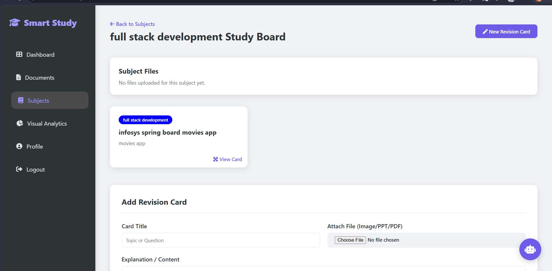
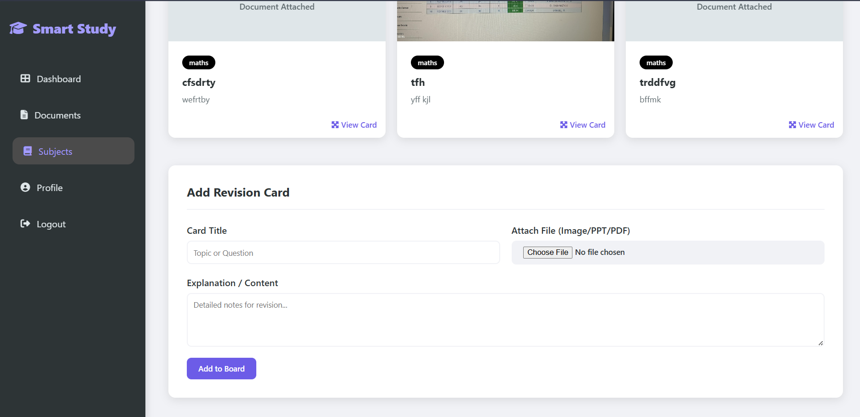
IMPLEMENTATION SCREENSHOTS
1
2
3
4
5
6
7
8(B)
9

Slide 13
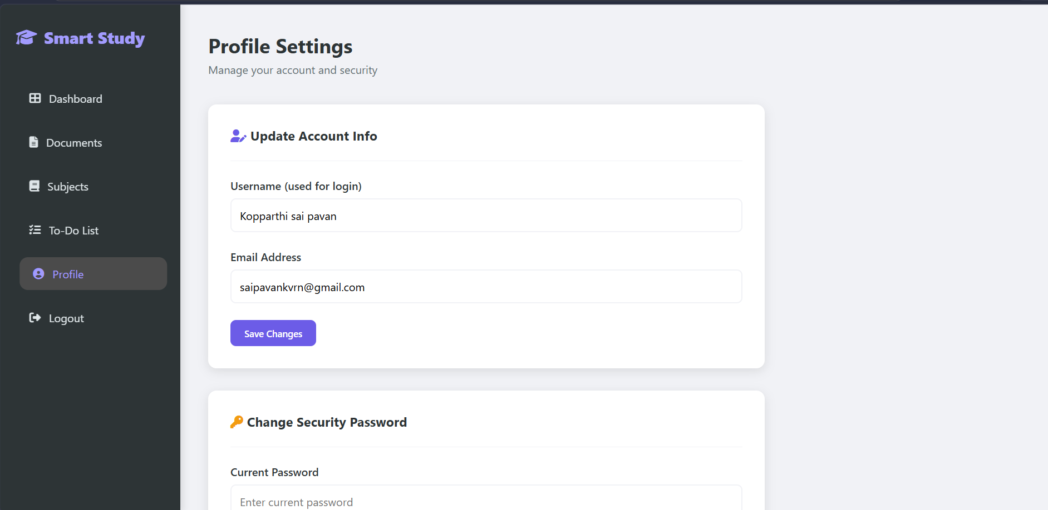
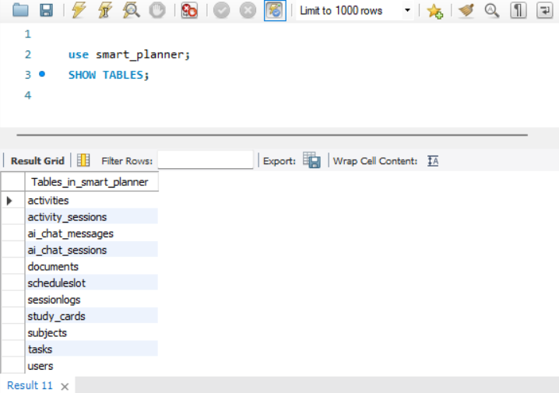
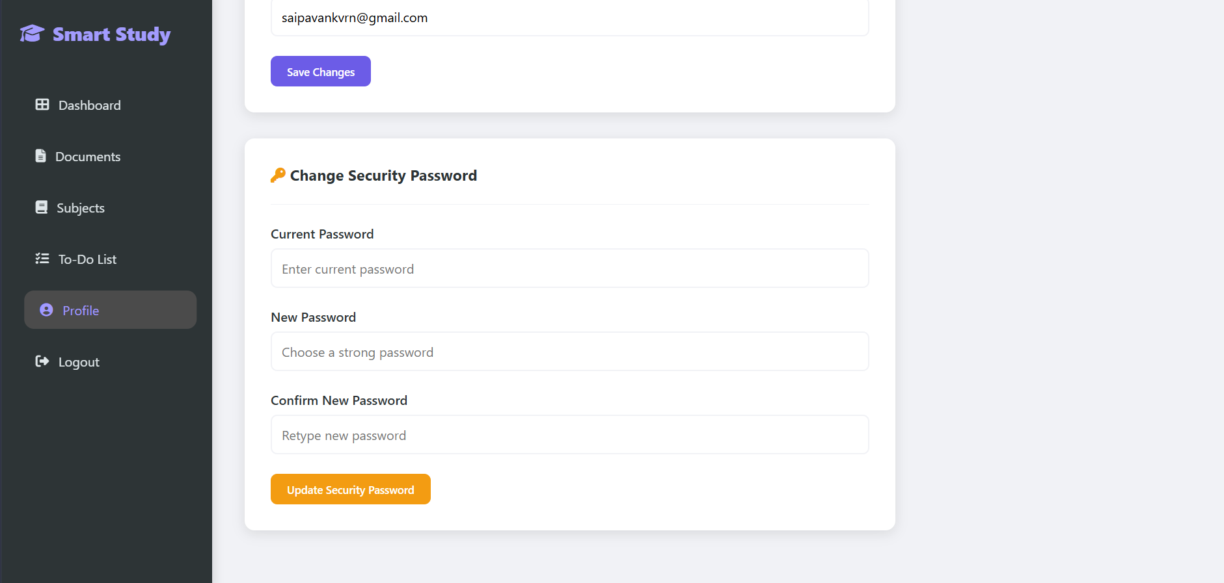
IMPLEMENTATION SCREENSHOTS
1
2
3
4
5
6
7
8(C)
9

Slide 14
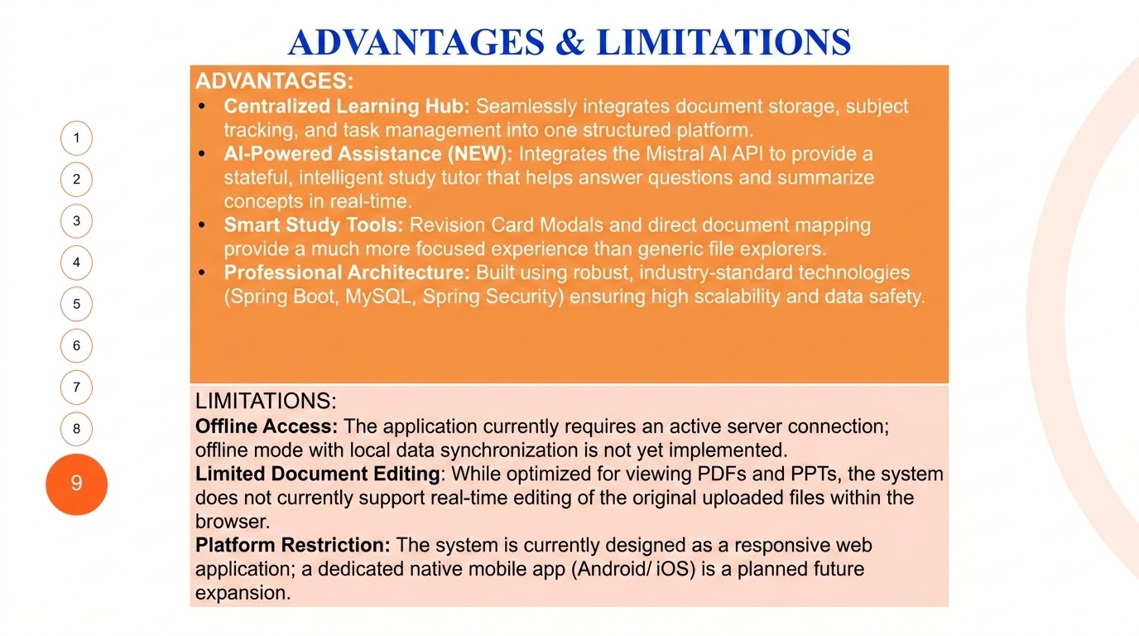

Slide 15
Thank you

